Slide 1

Tutorial Questions （Week 9）
Juntao Zhang(张峻滔), TA
Southern University of Science and Technology
Email: 12332164@mail.sustech.edu.cn

Slide 2
Outline
Review
Basic Problems with Answers 4.10 4.16
Basic Problems 4.26 4.30
Q&A

Slide 3
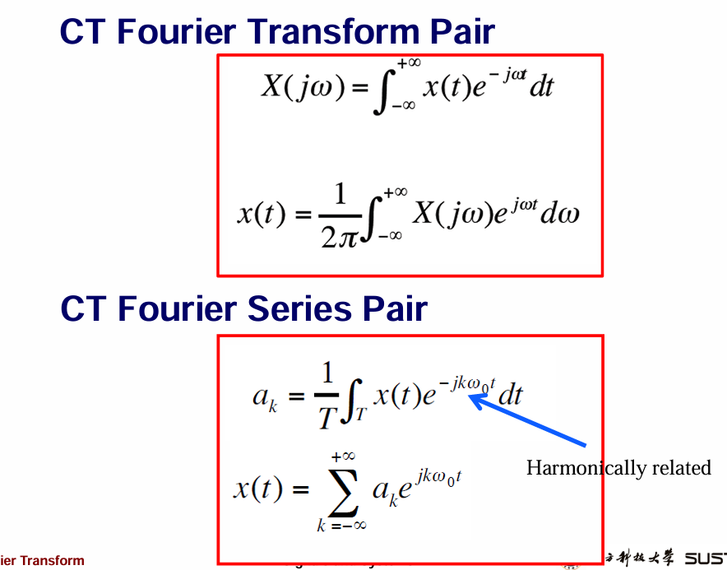


Slide 4
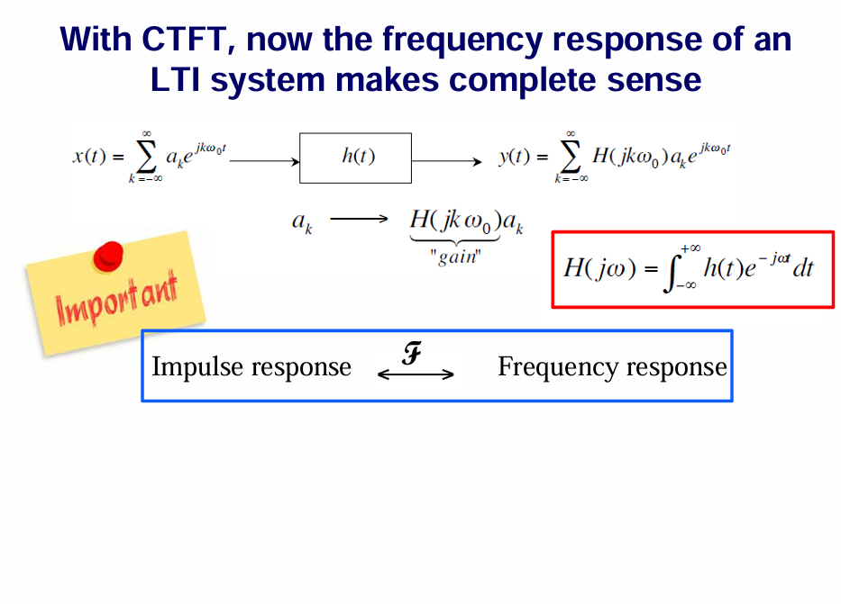

Slide 5
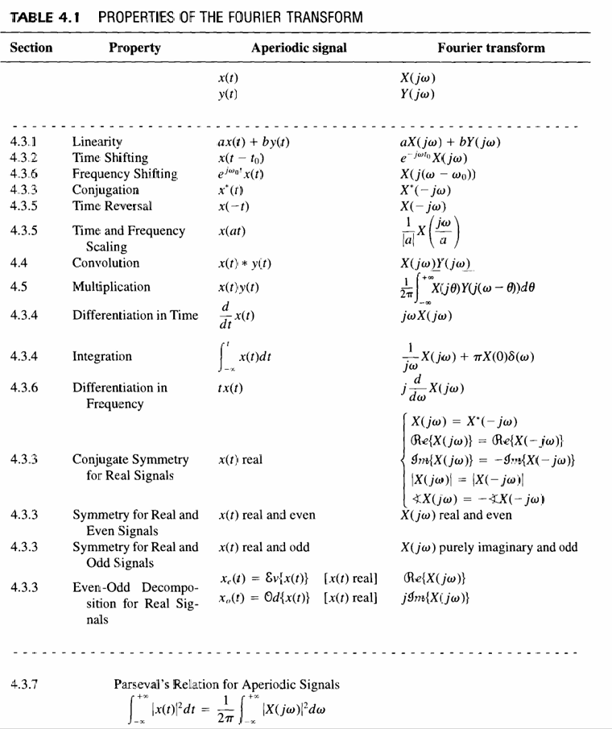
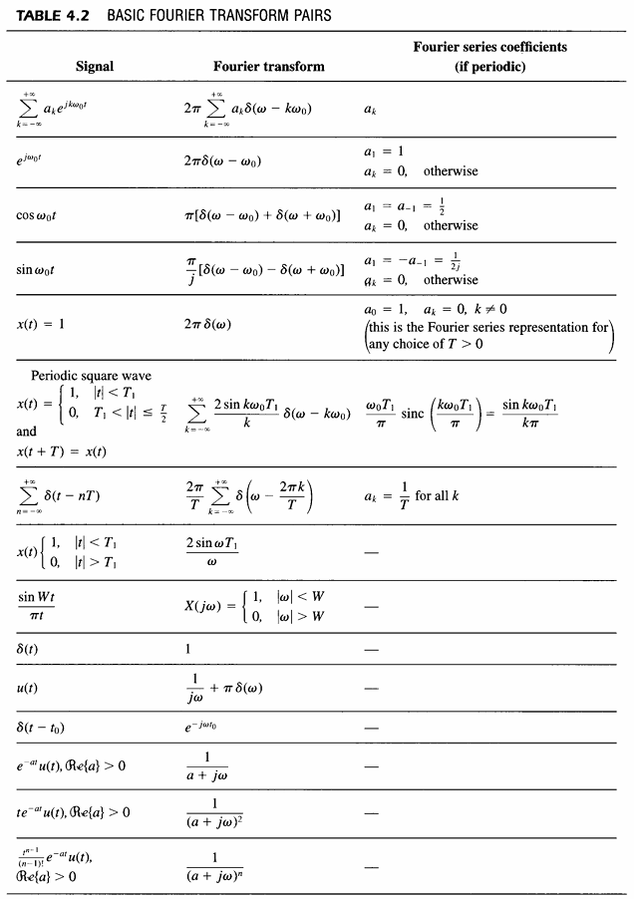

Slide 6
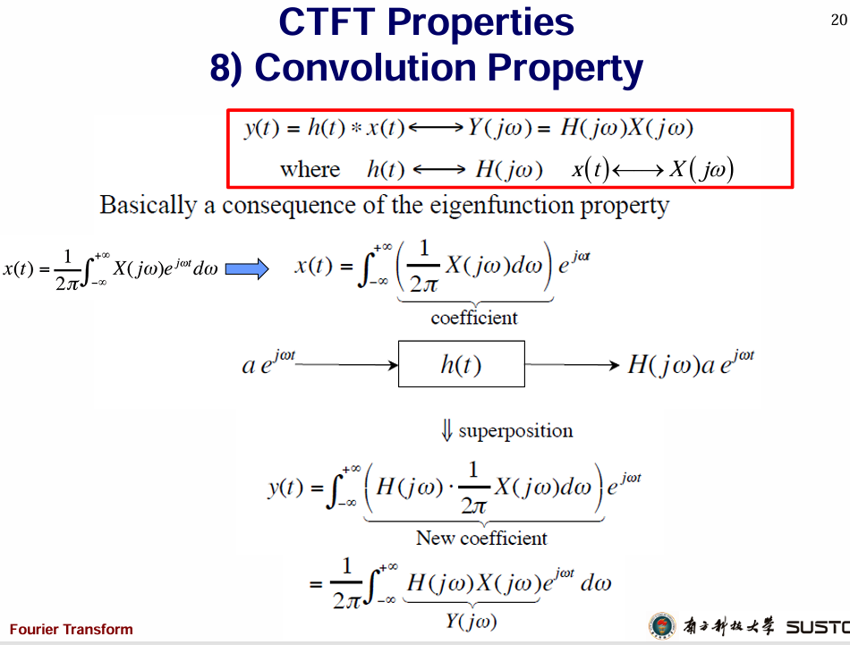


Slide 7
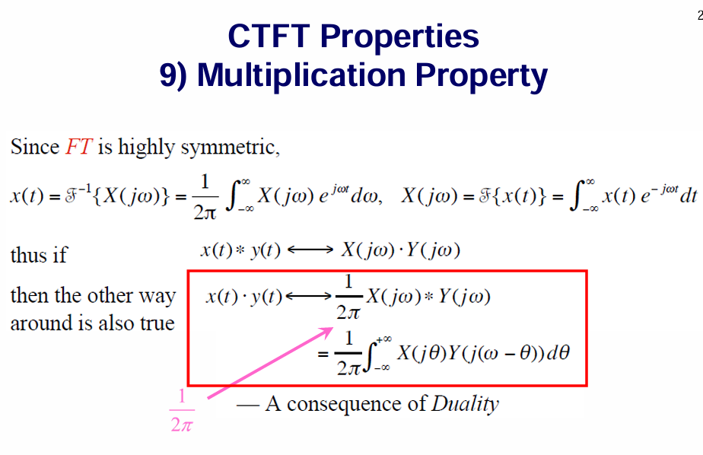

Slide 8
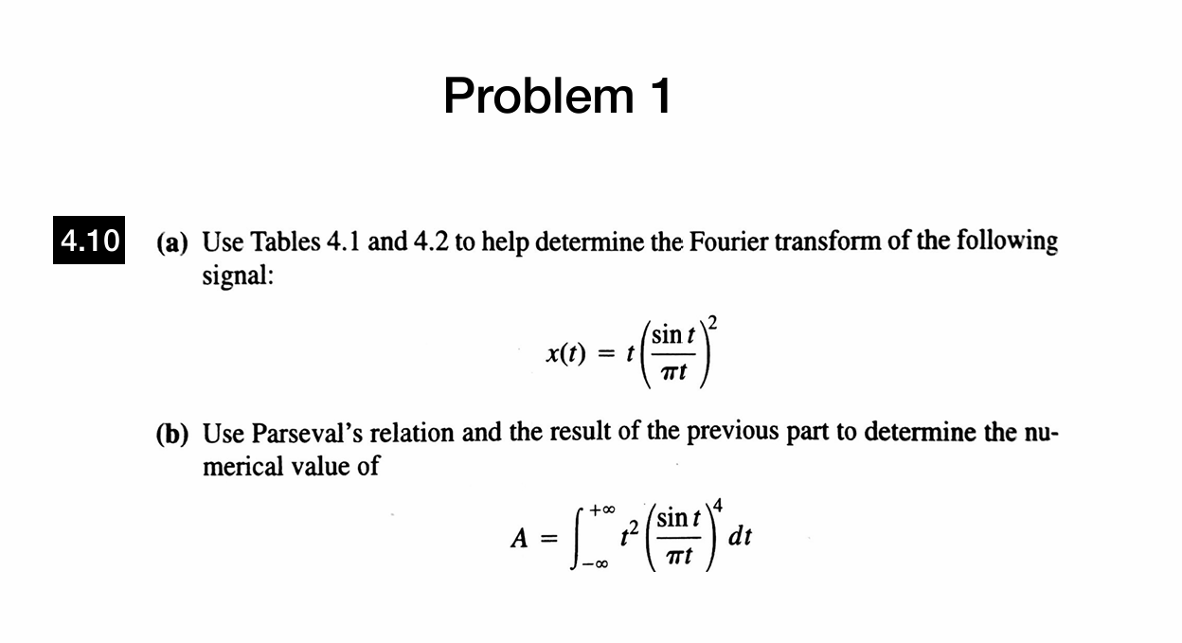

Slide 9
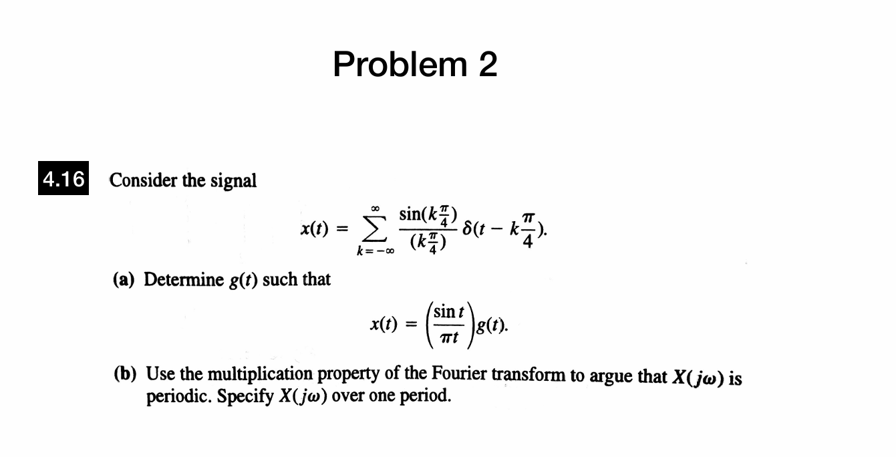

Slide 10
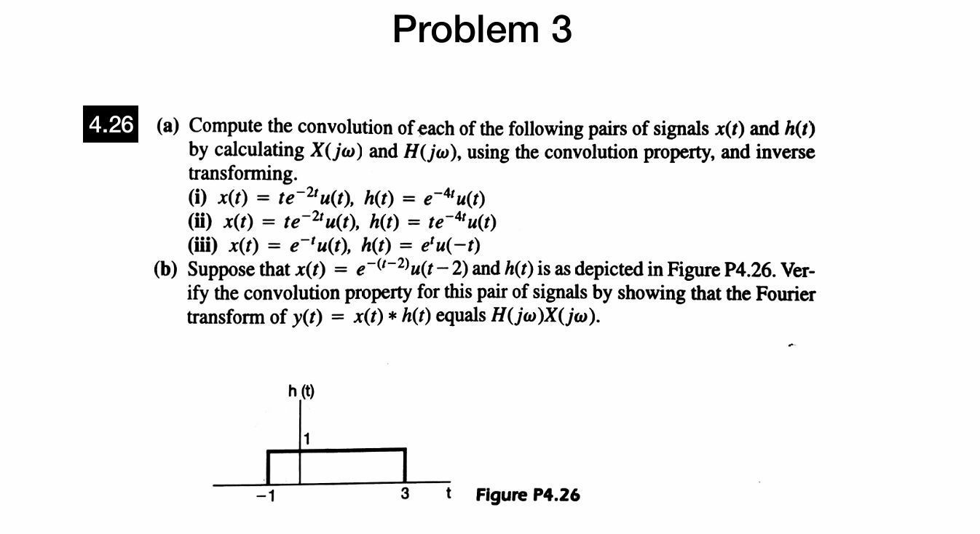

Slide 11
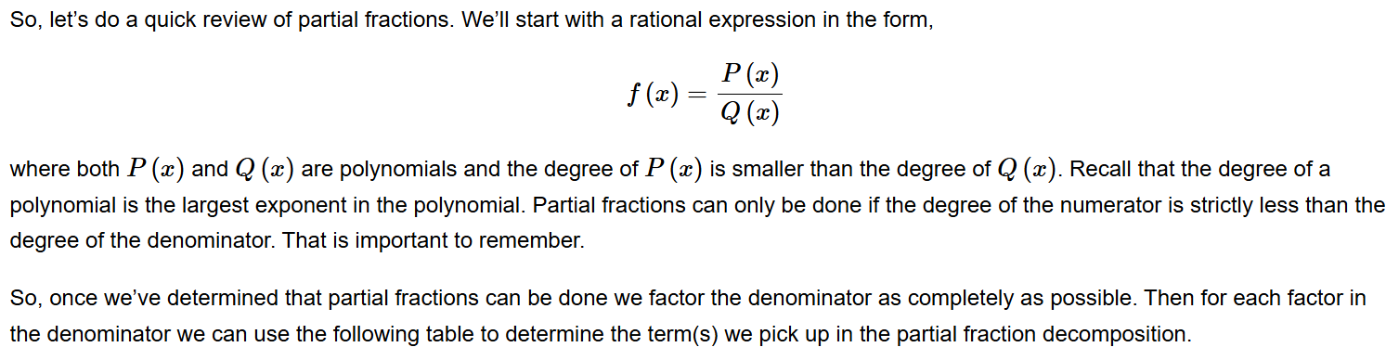
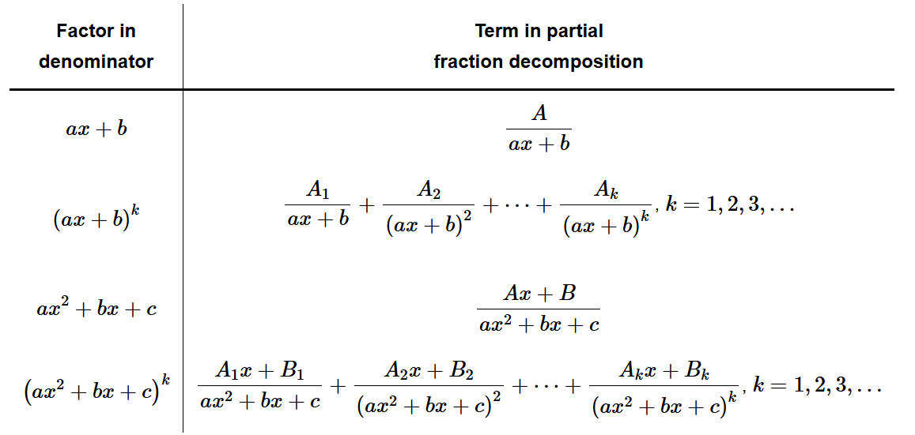
Partial Fractions

Slide 12
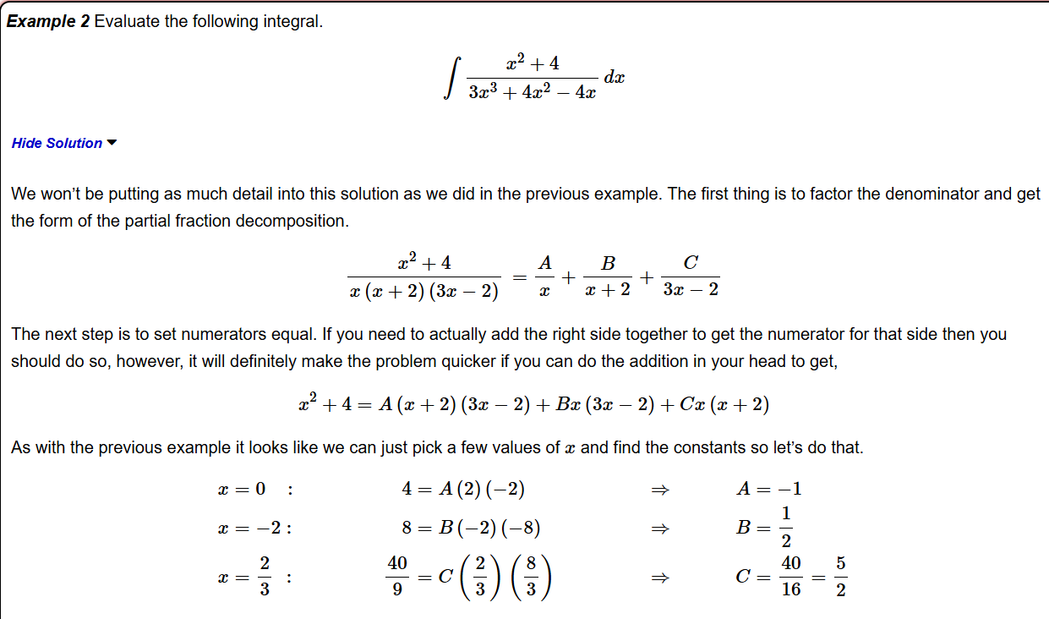

Slide 13
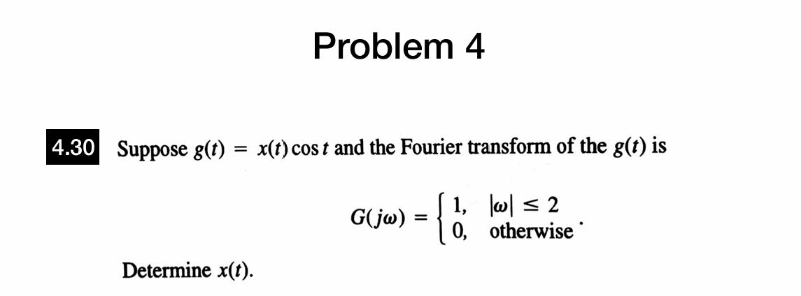

Slide 14
Thanks for Your Attendance
Q&A
Juntao Zhang(张峻滔), TA
Southern University of Science and Technology
Email: 12332164@mail.sustech.edu.cn

